Slide 1

Are you ready to be a hacker?

Slide 2


?

Slide 3
Outline
Definisi hacker
Klasifikasi hacker
Penetration Testing
CTF
Perintah-Perintah Dasar Linux dan CTF

Slide 4
Definisi Hacker
“One who enjoys the intellectual challenge of creatively overcoming or circumventing limitations.”
- http://www.mithral.com/~beberg/hacker.html

Slide 5
Definisi Hacker
“It means someone who enjoys playful cleverness, especially in programming but other media are also possible. [...]
One possible arena for playful cleverness is breaking security. Hackers never had much respect for bureaucratic restrictions. If the computer was sitting idle because the administrators wouldn't let them use it, they would sometimes figure out how to bypass the obstacles and use it anyway. If this required cleverness, it would be fun in itself, as well as making it possible to do other hacking (for instance, useful work) on the computer instead of twiddling one's thumbs. But not all hackers did security breaking. Many never were interested in that.”
--Richard Matthew Stallman, Founder of GNU (https://www.gnu.org/philosophy/rms-hack.html)

Slide 6
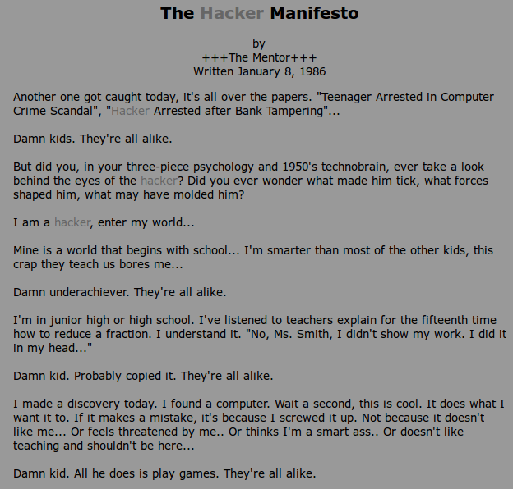
Hacker Manifesto
http://www.mithral.com/~beberg/manifesto.html

Slide 7

Klasifikasi Hacker
Black hat
Gray Hat
White hat

Slide 8

Black hat
“A black-hat hacker is a hacker who ‘violates computer security for little reason beyond maliciousness or for personal gain’”
- Moore, Robert on Wikipedia (https://en.wikipedia.org/wiki/Black_hat)

Slide 9

Grey Hat
“The term "grey hat" refers to a computer hacker or computer security expert who may sometimes violate laws or typical ethical standards, but does not have the malicious intent typical of a black hat hacker.”
– Wikipedia (https://en.wikipedia.org/wiki/Grey_hat)

Slide 10

White Hat
“The term "white hat" in Internet slang refers to an ethical computer hacker, or a computer security expert, who specializes in penetration testing and in other testing methodologies to ensure the security of an organization's information systems”
– Wikipedia (https://en.wikipedia.org/wiki/White_hat_%28computer_security%29)

Slide 11
Penetration Testing
“Penetration testing (pen-testing or pentesting) is a method of testing, measuring and enhancing established security measures on information systems and support areas.”
--Technopedia (https://www.techopedia.com/definition/16130/penetration-testing-pen-testing)

Slide 12
CTF (Capture the flag)
“CTF contests are usually designed to serve as an educational exercise to give participants experience in securing a machine, as well as conducting and reacting to the sort of attacks found in the real world. Reverse-engineering, network sniffing, protocol analysis, system administration, programming, and cryptanalysis are all skills which have been required by prior CTF contests at DEF CON.”
--https://en.wikipedia.org/wiki/Capture_the_flag

Slide 13

Beberapa sumber latihan CTF
OverTheWire.org
VulnHub.com
www.owasp.org

Slide 14
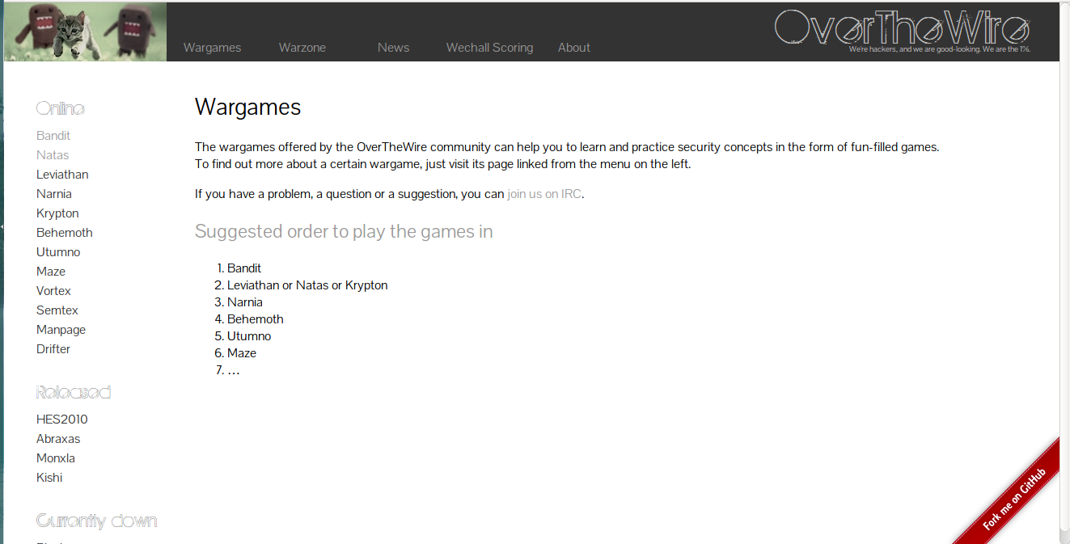
Over the wire

Slide 15
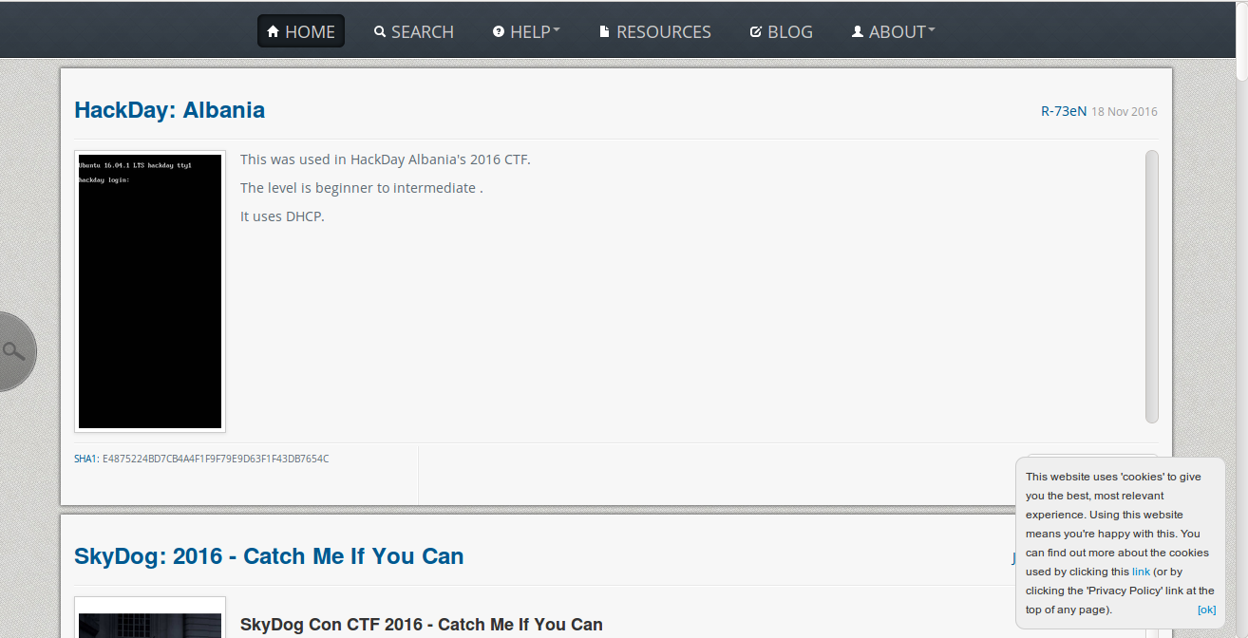
Vuln Hub

Slide 16
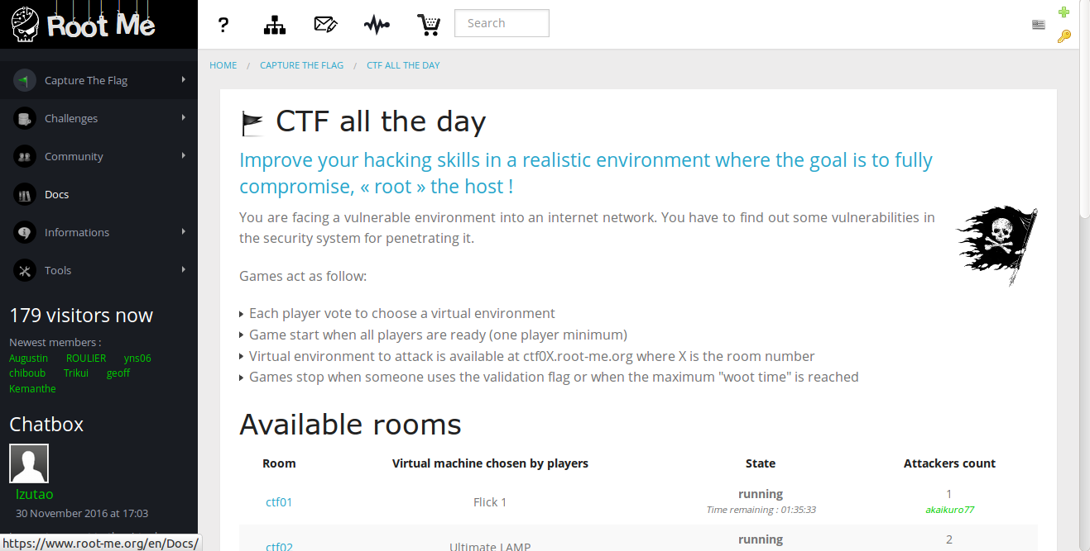
Root me

Slide 17
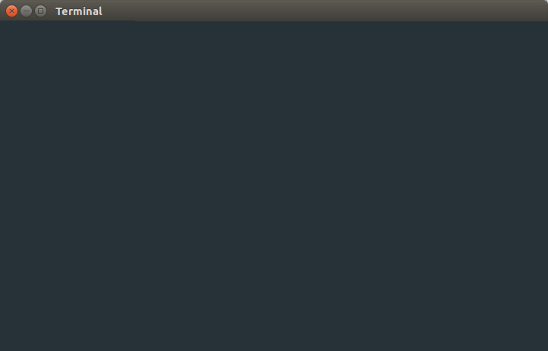
Kawan setia anda: terminal

Slide 18
Dasar-dasar perintah di Linux yang akan digunakan di dalam CTF
cd
ls
ssh
cat
file
|
grep
find

Slide 19
Dasar-dasar perintah di Linux yang akan digunakan di dalam CTF
sort
tr
tar
gzip
bzip
xxd
strings
telnet
nc
openssl

Slide 20
Beberapa Perintah di Linux yang digunakan untuk CTF
s_client
nmap

Slide 21
man command
Perintah-perintah berikut ini penjelasannya disederhanakan bila ingin penjelasan panjangnya silakan buka “man nama-perintah” di terminal

Slide 22
cd (change directory)
Fungsi: pindah ke direktori lain di Linux
Contoh:
cd ..
cd nama-folder/
cd /
cd ~

Slide 23
ls
Fungsi:
menampilkan daftar file dan direktori di dalam sebuah direktori
Contoh:
ls .
ls ..
ls
ls -al .

Slide 24
ssh
Digunakan untuk mengendalikan sistem dari jarak jauh. Penggunaan:
ssh nama-user@alamat-host
misalnya:
ssh udin@udin.com
ssh ika@10.10.1.55

Slide 25
cat
Fungsi:
membaca file teks
contoh:
cat nama_file.txt

Slide 26
file
Fungsi:
menentukan jenis file
contoh:
file nama_file.txt

Slide 27
find
Fungsi:
menemukan file-file dengan kriteria pencarian tertentu di dalam sebuah direktori
contoh kriteria pencarian:
-user nama-user
-perm kode-izin
-group nama-group
-size: +n: lebih besar dari n; -n: lebih kecil dari n; n: persis n

Slide 28
find
Contoh:
Mencari file dengan ukuran 78 byte, owner rita, lokasi /home/:
find /home -size 78 -user rita

Slide 29
file
Fungsi:
menentukan jenis file
contoh:
file nama_file.txt

Slide 30
grep
Fungsi:
mencari karakter/ kata yang sesuai dengan masukan dan mencetak baris teks yang mengandungnya
contoh:
grep banana teks.txt

Slide 31
|
Fungsi:
menyalurkan output suatu perintah menjadi input dari perintah lain
contoh:
cat teks.txt | grep banana

Slide 32
sort
Fungsi:
mengurutkan baris-baris di teks di dalam suatu file menurut kriteria tertentu
contoh:
sort nama_file.txt

Slide 33
tr
Fungsi:
mengubah karakter/ string tertentu di dalam sebuah teks dengan karakter/string yang baru. tr bekerja dengan redirection < atau pipe | dengan kombinasi perintah lain
contoh:
cat teks.txt | tr a b
Artinya mengubah seluruh karakter a di tampilan file teks.txt menjadi huruf b

Slide 34
tr
contoh:
cat teks.txt | tr a-f g-l
Artinya mengubah tiap karakter dalam rentang a-f di file teks.txt menjadi karakter dalam rentang gl, misalnya:
a menjadi g, b menjadi h

Slide 35
tar
Fungsi:
memasukkan file-file ke dalam suatu file arsip bertipe tar
contoh:
memasukkan file: tar -cf arc.tar file1 file2 atau
mengeluarkan file-file dari arsip: tar -xf arc.tar

Slide 36
gzip
Fungsi:
mengompres file ke dalam format gzip
contoh:
kompresi: gzip -c a > g.gz
dekompresi: gunzip -k g.gz

Slide 37
bzip2
Fungsi:
mengkompresi dan dekompresi file menggunakan algoritma Burrows-Wheeler dan Huffman coding
contoh kompresi:
bzip2 nama_file.txt
Contoh dekompresi:
bzip2 -dk nama_file.bzip

Slide 38
strings
Fungsi:
membaca karakter yang dapat dibaca dari file
contoh:
strings namafile

Slide 39
xxd
Fungsi:
menampilkan/membuat hexdump (data hexadecimal) dari sebuah file dan sebaliknya
contoh:
menampilkan hexdump: xxd namafile
mengembalikan: xxd -r namafile
Gunakan > jika ingin menuliskannya ke file

Slide 40
telnet
“The telnet command is used for interactive communication with another host using the TELNET protocol.” -telnet manual page on linux
Penggunaan:
telnet namahost port
Contoh:
telnet localhost 80

Slide 41
openssl
“OpenSSL is a cryptography toolkit implementing the Secure Sockets Layer (SSL v2/v3) and Transport Layer Security (TLS v1) network protocols and related cryptography standards required by them.” - openssl manual page on linux

Slide 42
nmap
“Nmap (“Network Mapper”) is an open source tool for network exploration and security auditing. It was designed to rapidly scan large networks, although it works fine against single hosts” - nmap manual page on linux
Contoh penggunaan:
nmap -A -T4 scanme.nmap.org

